Slide 1
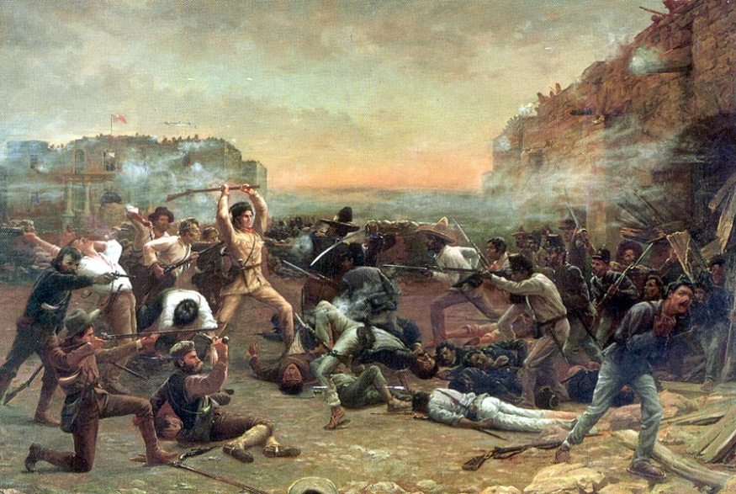
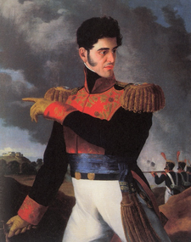
Major events of the Texas Revolution

Slide 2
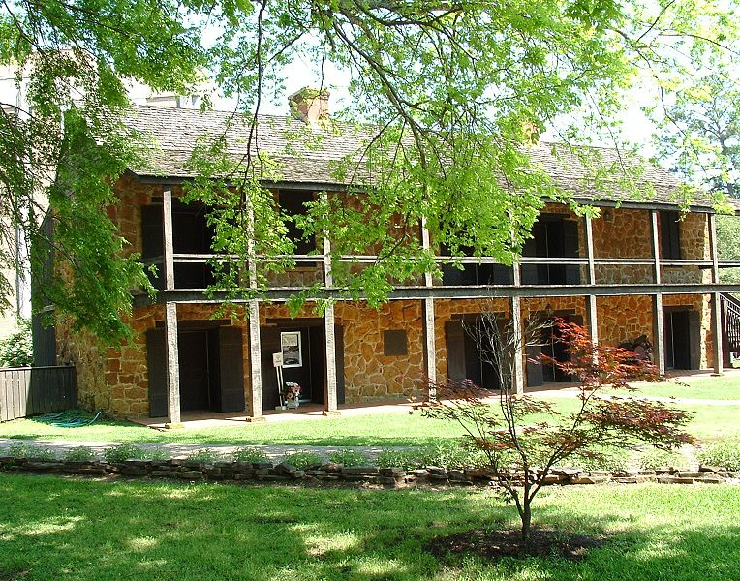
Fredonia Revolt
The Revolt occurred in 1826.
The year was 1826, and talk of independence had come up. Hayden and Ben Edwards, collected a group of 20 to 30 Anglo settlers, and sieged on the Republic of Fredonia. The Rebellion had not lasted long: they raised a red and white flag over it proclaiming it free. However it was easily overthrown by the Mexican Army.
However this alarmed Mexico by thinking
Americans wanted Texas as a part of them.
Mexico would then send Manuel Meir y Teran
to investigate.

Slide 3
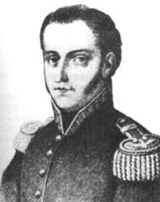
Mexico learns of American intrest(1827-1829)
Mexico did route Manuel to the Texas colonies to “do some snooping.”
Manuel Teran s trip to Texas lasted a two-year period.
During this time, rumors were confirmed that America did in fact wish Texas to become an American State.
Manuel Meir y Teran made it very clear to Mexico that they must act quickly if they intended to keep Texas.
This would lead to the Law of April 6, 1830.

Slide 4
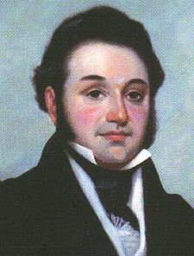
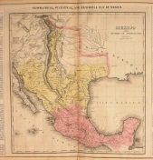
Due to Teran’s assessment of Texas, in 1829, Mexico had imposed a law of April 6 this is a law that banned immigration, further settling, and controlled importing more strictly. However this did not prevent people from migrating to Texas by the thousands
It is estimated that 30,000 Texans lived there,
Compared to 7.800 Mexican Soldiers.
Law of April 6 1830…

Slide 5
The protest at Anahuac
Mexican soldiers arrested William Travis, (a lawyer) on charges of returning a slave to his master. Mexico at the time prohibited slavery. The colonist were outraged at this; a mob was formed and they stormed the jail, demanding their release.
This was one of two major spurs of the revolution.
The second was: settlers were accusing their sponsor Bradburn, of unlawfully taking supplies and not being fair to the citizens.
By this point, Texas was exhausted of patience.
However, Texas had been consistently apologizing for their minor skirmishes and attacks.
Now it was Mexico's turn to get upset.
in 1832, a set of skirmishes
led to the retreat of settlers at
Turtle Bayou.
Here a draft explaining their
actions was written. This was highly
disregarded by the Mexican Government.
BUT REMEMBER THIS! (its important!)
These Rebellious Protest occurred in 1832.

